Slide 1
COUNSELOR
LETTER OF RECOMMENDATION WORKSHOP
2024-2025
- LOS ALTOS HIGH SCHOOL -
Notes:
Tamesha

Slide 2
ADMISSION FACTORS
Colleges & universities may consider the following factors for admission:
Rigor of coursework
Grades & GPA
SAT/ACT results
Extracurricular activities
Civic engagement
Interview
Application questions/essay
Teacher & counselor recommendations
Check each college/university website for details on specific admission criteria
Notes:
Tamesha

Slide 3
LETTERS OF RECOMMENDATION
Required by most private 4-year colleges & Common App schools
UC/CSUs do NOT accept letters*, nor do most out-of-state public colleges
*UC Berkeley may request recommendations from some students after applications have been submitted
Typically 1-3 letters are required from teachers & counselor
Some colleges also accept a supplemental letter from a boss, coach, etc.
Notes:
Tamesha

Slide 4
TEACHER LETTERS OF RECOMMENDATION
Separate from the counselor letter of rec process
Teachers have their own deadlines & requirements
Teachers use Naviance to send their letters
Do not use the “recommender” feature in Common App for MVLA teachers/staff
This will break the connection between your Common App & Naviance accounts
Notes:
Tamesha

Slide 5
TEACHER LETTERS OF RECOMMENDATION
11th grade teachers preferred
Academic subjects preferred (unless applying for special programs like Visual/Performing Arts colleges)
Ask teachers in person, then add them as recommenders in Naviance once you have synced your Common App account
Notes:
Tamesha

Slide 6
COUNSELOR LETTER OF RECOMMENDATION
The counselor letter provides a holistic view of the student beyond academics
Letter reflects on:
Academic achievement Character/attitude College readiness | Contributions to community Special circumstances
LAHS counselors use input from personal interactions, teachers, parents, and students all compiled in the
Counselor Letter of Recommendation Request Form
Notes:
Ryan

Slide 7
Notes:
Ryan

Slide 8
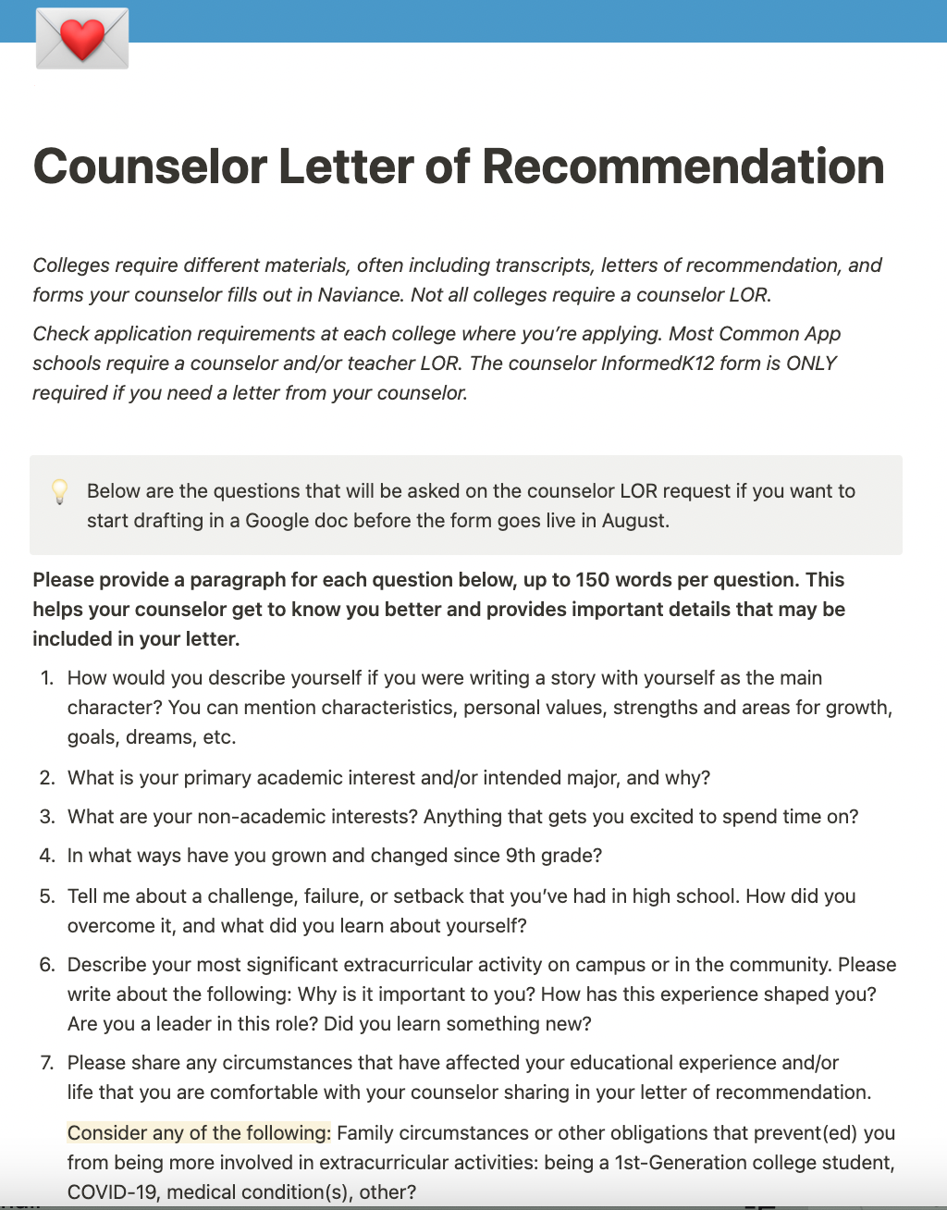
COUNSELOR LETTER OF REC QUESTIONNAIRE
Draft all writing in Google Docs
Notes:
Ryan

Slide 9
COUNSELOR LETTER OF REC FORM - IMPORTANT DATES
9/11
10/2
12/15
For deadlines after Nov. 15, submit your request by Monday, Oct. 2, 2023
If your first deadline is on or before Nov. 15 (EA, ED, scholarship), you must submit your LOR Request Form by Monday, Sept. 11, 2023
The last day to request any counselor forms or initial transcripts for submission before holiday break is Friday, Dec. 15, 2023
Notes:
Ryan

Slide 10
COUNSELOR LETTER OF REC REQUEST
Can I still add more colleges after I submit my letter of rec request? Yes, and...
Tell your counselor ASAP if you first college deadline changes
Be sure to change on Common App and Naviance
The College & Career Center sends scholarship & visit info to you based on your list - we don’t want you to miss out on events!
Notes:
Ryan

Slide 11
COUNSELOR LETTER OF REC REQUEST
Fall/Winter:
Counselor submits LOR, Secondary Report, transcript
End of January:
Counselor submits MidYear Report & midyear transcript
June/July:
Student requests final transcript in Naviance (sr.checkout)
Counselor completes Final Report
Registar submits final transcript/report
Notes:
Ryan

Slide 12
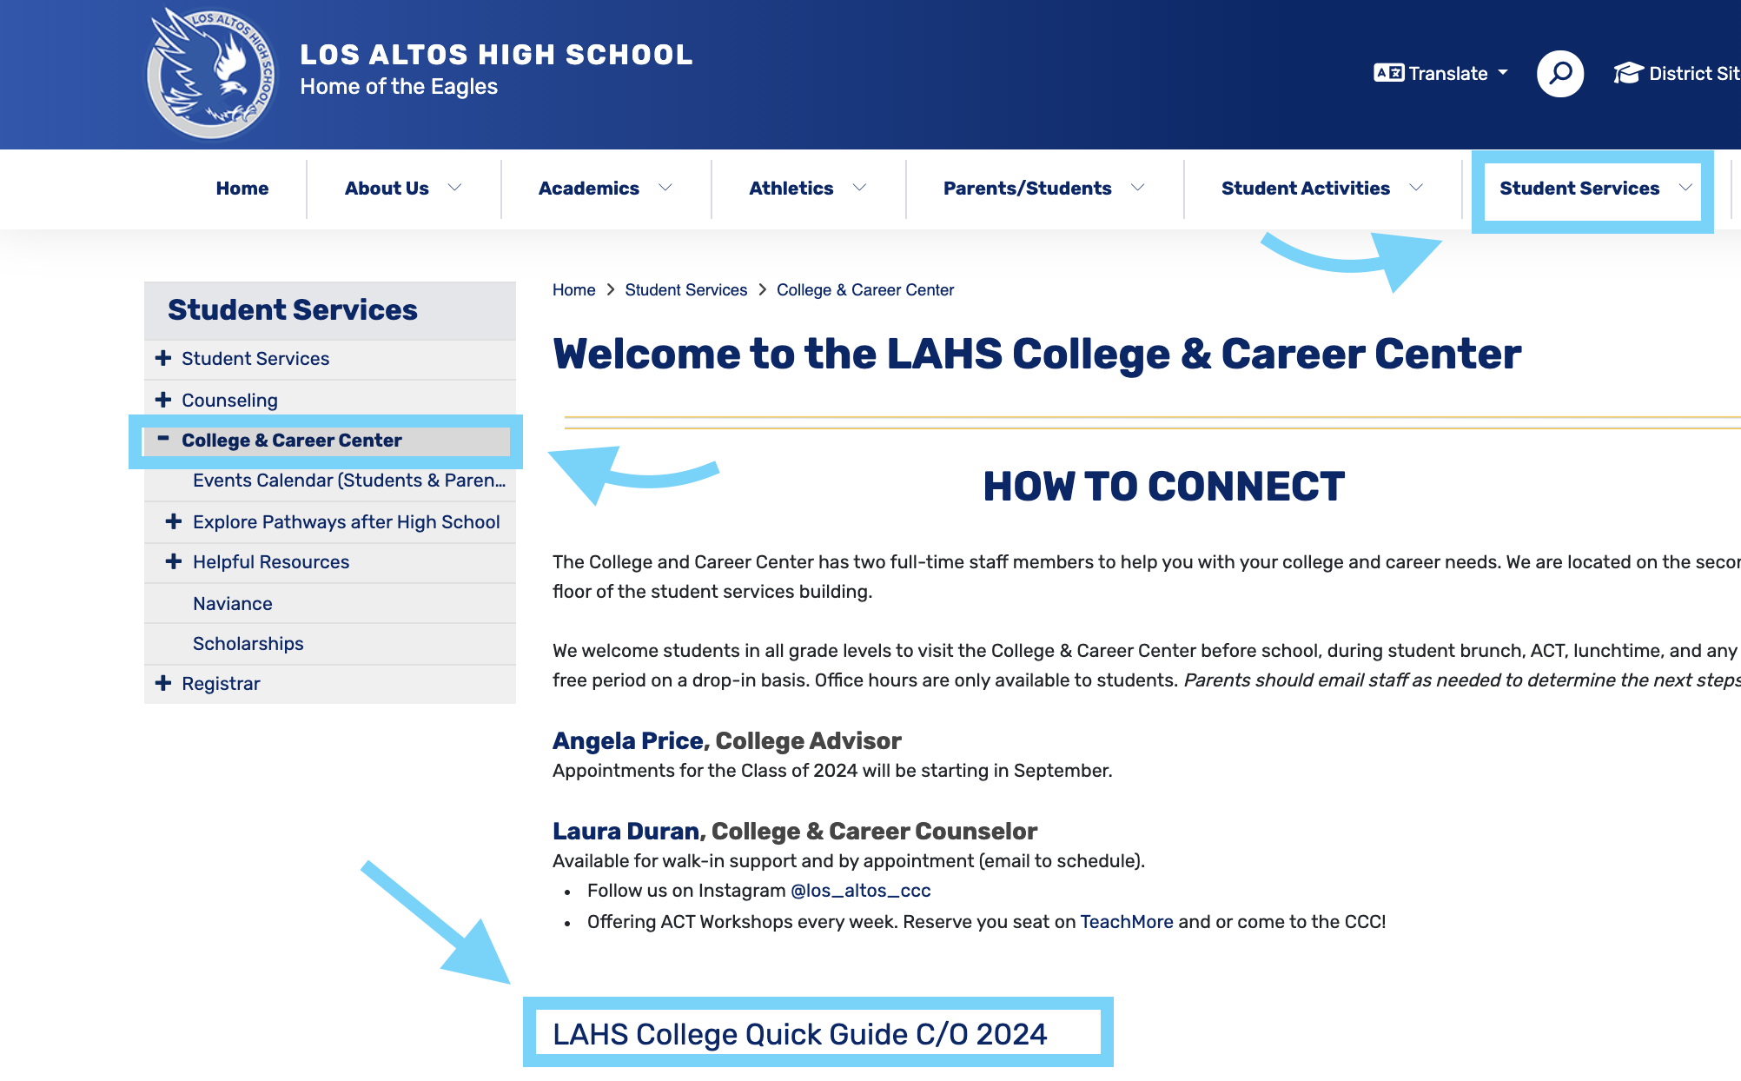
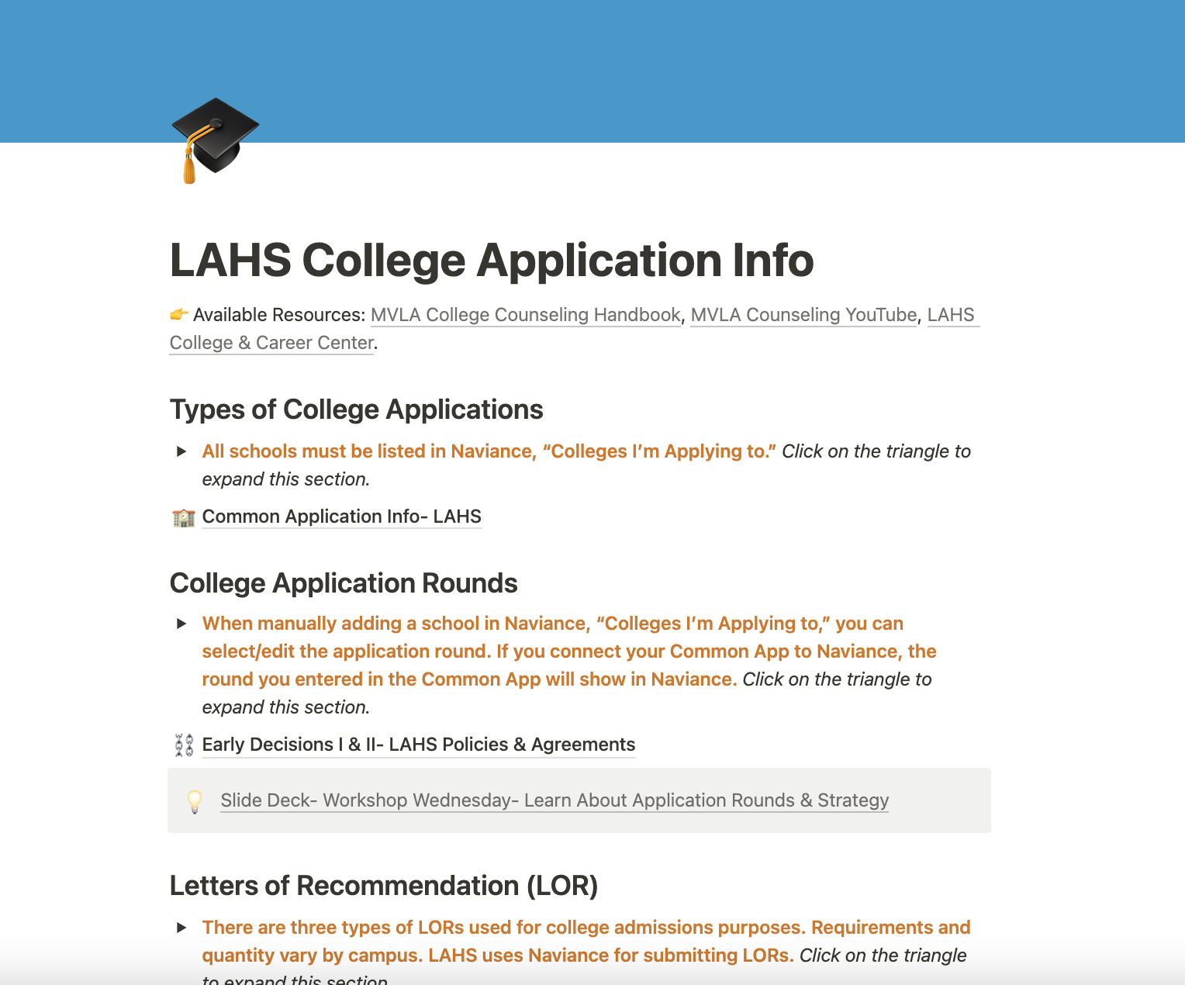
COLLEGE APPLICATION QUICK GUIDE
NEW
Notes:
Laura

Slide 13
APPLICATION ROUND DETERMINES DEADLINE
Notes:
Laura

Slide 14
WHAT NOW?
Ask max 2 teachers for a letter of rec
Create college application accounts (UC, Common App, etc.)
UC application opened on Aug 1 for Fall 2023 applications
Add colleges to your “Colleges I’m Applying To” list in Naviance
Complete the Counselor Letter of Recommendation Request
Start drafting college essays, especially for Nov. 1 deadlines
Go to the College & Career Center for support!
Notes:
Laura

Slide 15
NAVIANCE
USE IT
Notes:
Laura Naviance is an important tool, make sure you have access and know how to log in
several application components are sent via Naviance by teachers and counselors

Slide 16
APPLICATION PLATFORMS
Apply to many private colleges & some out-of-state public colleges using one application
Notes:
There are several college application portals, these are the 4 that LAHS students utilize the most (depending on the colleges they apply to)
Only the Common App requires you to match your account to Naviance
If using the Coalition, you do not need to request your recommender or counselor items through Coalition, you can do so through Naviance
UC application does not open until August 1, Cal State Apply opens October.

Slide 17
FERPA WAIVER
1
2
3
Add at least one college to your Common App list
Complete the Education section
Complete the Release Authorization for FERPA
Notes:
Family Educational Rights and Privacy Act is a law, for the purpose of letters of rec
Signing the release and waiving your rights to read your recommendation letters, communicates to the colleges that your letters hold more weight and are true and honest report and reflection

Slide 18
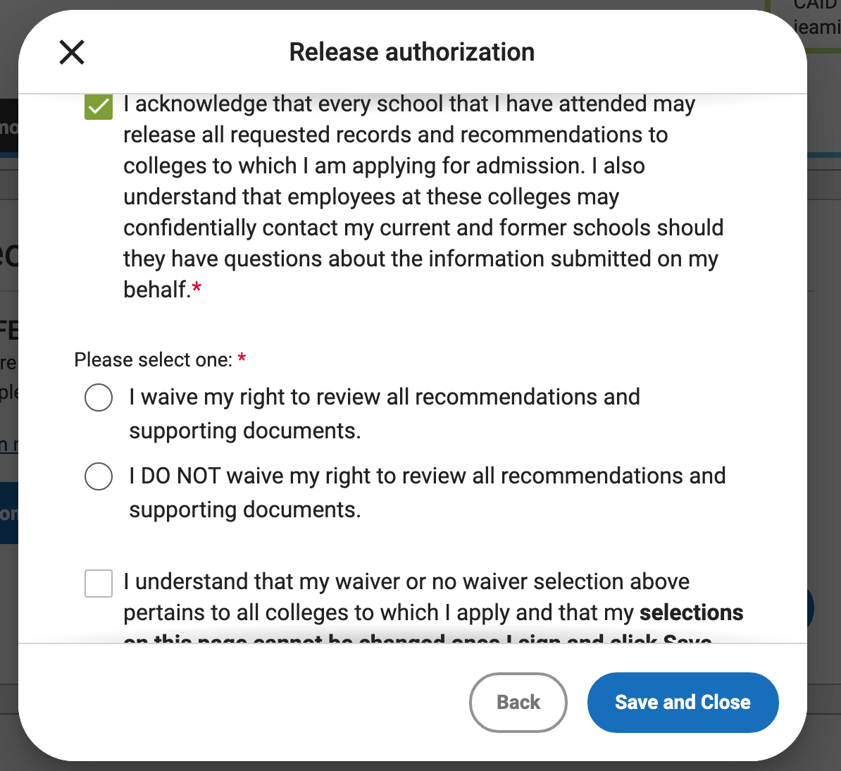
Notes:
Step 3- Follow the prompts. Students are encouraged to select the first option: I waive my rights to review all recommendations and supporting documents. This indicates to colleges that your supporting documents and letters of recommendation

Slide 19
FALL COLLEGE SUPPORT
College & Career Center
1:1 College Advising with Ms. Price (Apt. Link)
ACT Workshops- sign up on Teachmore
Notes:
Plug for CCC support during summer, get a head start.

Slide 20
QUESTIONS

